Slide 1
CSF 2113 Programming for Information Security
CLO1: Iterations
Muhammad Humayoun, PhD
Assistant Professor
mhumayoun@hct.ac.ae
Abu Dhabi Men’s College

Slide 2
Loops / Iteration
for loop
range function
Flow control within loops: break, continue, pass, and the “loop else”

Slide 3
While: Overview
We can use a while statement to repeatedly execute a series of tasks (i.e. a loop).
Syntax Example
initialization n = 0
while condition: while n < 10:
statement(s) print n
increment/decrement n = n + 1

Slide 4
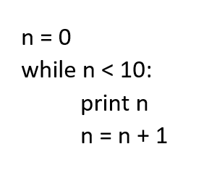
While: Control Flow
Evaluate condition (which is a Boolean expression).
If condition is False, then exit loop and continue program.
If condition is True, then execute statements in body and then go to step 1.

Slide 5
While: Notes
Each time through the body of a loop is called an iteration.
The condition normally contains a variable that changes within the body of the loop so that we can eventually exit the loop.
If a loop never exits, then this is called an infinite loop.

Slide 6
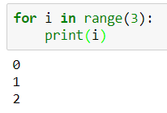
for loop: for ... in pattern
Used with collection data types which can be iterated through (“iterables”):
for i in [0,1,2] : print (i) Output: 0 1 2
Extract one element from the list.
Execute the body of for loop with item bound to the element.
Go to step 1.

Slide 7
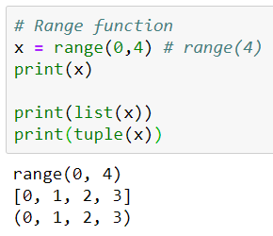
The range function…
range(n) returns a list of integers from 0 to n-1.
range(0, 10, 2) returns a list 0, 2, 4, 6, 8
Similarly we have
str(), int(), float(), ….

Slide 8
Simple examples
Print each fruit in a fruit list:
fruits = ["apple", "banana", "cherry"] for x in fruits: print(x)
Looping Through a String
Loop through the letters in the word "banana":
for x in "banana": print(x)

Slide 9
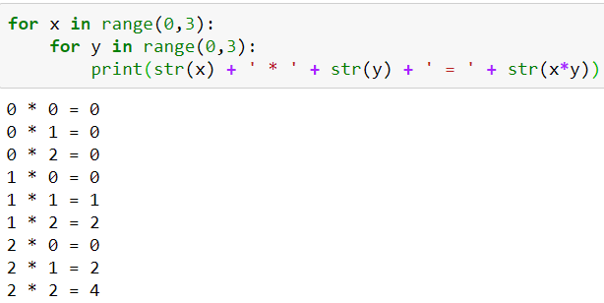
Nested loops

Slide 10
Activity: Loop Exercise
Find the smallest item in a list of numbers.

Slide 11
Flow control within loops
General structure of a loop: while <statement> (or for <item> in <object>): <statements within loop> if <test1>: break # exit loop now if <test2>: continue # go to top of loop now if <test3>: pass # does nothing! else: <other statements> # if exited loop without # hitting a break

Slide 12
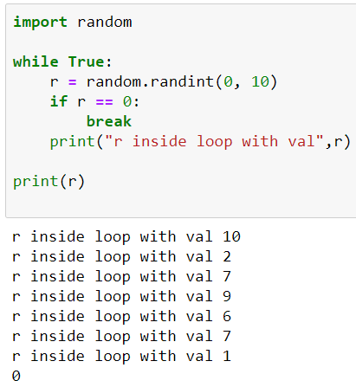
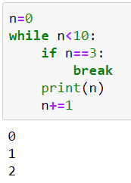
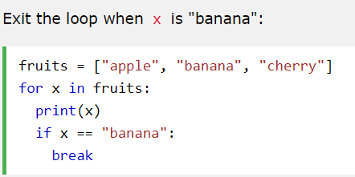
Break
We can exit a loop immediately by using the break statement
apple
banana
Important to observe where do you break

Slide 13
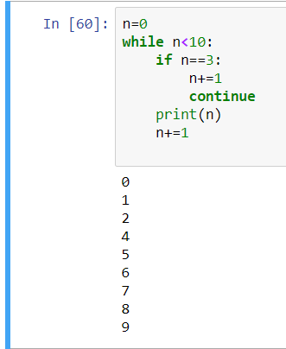
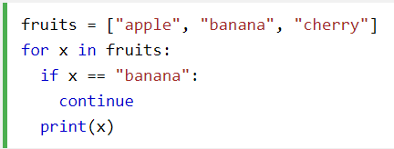
Continue
We can skip the rest of the loop body and move on to the next iteration by using continue
apple
cherry

Slide 14
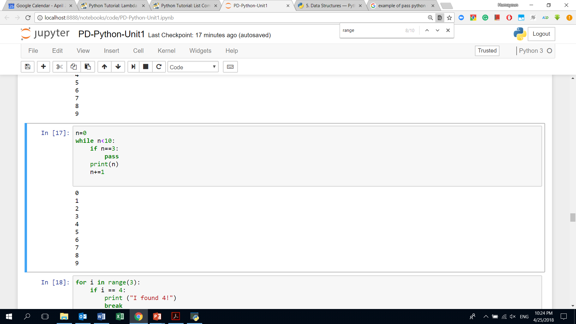
Pass
We do nothing
Can act as a placeholder
A typical example: designing a new class with some methods that we don't want to implement yet
https://stackoverflow.com/questions/13886168/how-to-use-the-pass-statement-in-python

Slide 15
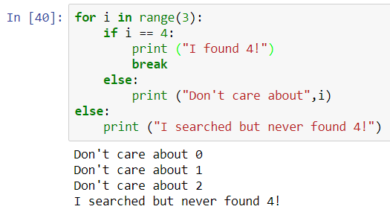
Using the “loop else”
An else statement after a loop is useful for taking care of a case where an item isn't found in a list:

Slide 16
Activity: Guessing Game revisited
Write code that generates a random number between 0 and 100, and asks the user to guess what it is
Guess the number: 10 Guess a lower number!
Guess the number: 3 Guess a higher number!
Guess the number: 2 You got it!
If the guess is too low, tell the user to guess 'Higher!'
If the guess is too high, tell the user to guess 'Lower!'
End the program when the user has found the number

